Slide 1
Image Transfer in MeasurementLink

Slide 2
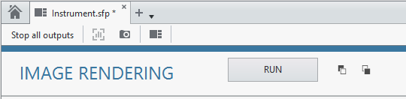
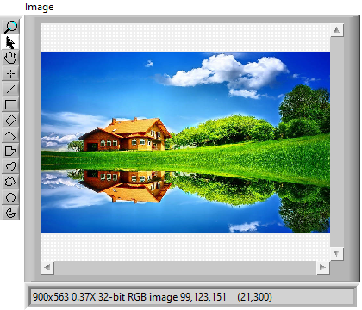
POC on Image transfer to InstrumentStudio
Unpack Configuration
Trigger from IS
Load Image from disk
Convert Image to gRPC supported type
Pack and send the result
Image data through
gRPC
LabVIEW Measurement
InstrumentStudio
Convert back to Image
+
Visualize in IS

Slide 3
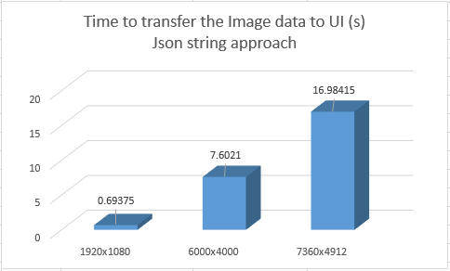
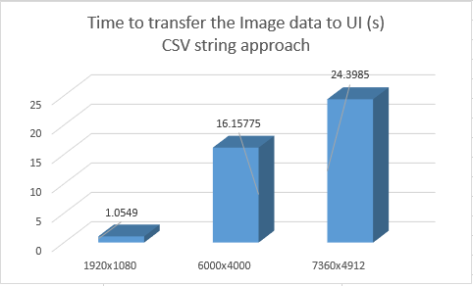
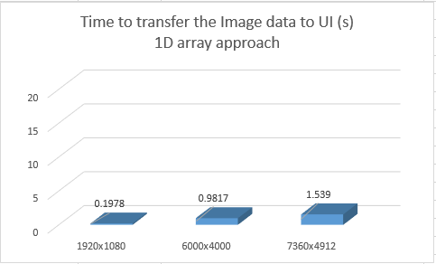
Time Taken to transfer image data

Slide 4
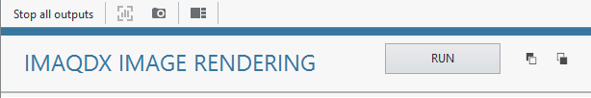
Image Streaming
Unpack Configuration
Trigger from IS
Acquire stream of images
7.4 ms per frame
Convert Image to gRPC supported type
Pack and send the result
gRPC streaming in
loop
LabVIEW Measurement
InstrumentStudio
Convert back to Image
+
Visualize in IS

Slide 5
Approximate Time Taken to transfer a frame
S.NO | Resolution (x*y) | Average Time Taken for sending each frame of image | Approach | Frame Rate
1 | 1280x720 | 7.4 ms | Compressed string to byte array | 30 fps
2 | 1280x720 | 15 ms | U32 1D array
3 | 1280x720 | 75ms | Json string
4 | 1920x1080 | 10 ms | Compressed string to byte array
5 | 1920x1080 | 30 ms | U32 1D array
6 | 1920x1080 | 1.3 s | Json string

